Slide 1

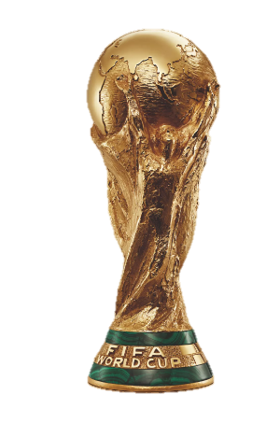
Group Member 6 : Class DT2206L
Nguyễn Sỹ Hải Nam
Trần Thanh Trúc
Trần Tuấn Vũ
Instructor : Hồ Nhựt Minh

Slide 2
FACTORS AFFECTING THE WINNING ABILITY OF TEAMS PARTICIPATING IN THE WORLD CUP

Slide 3
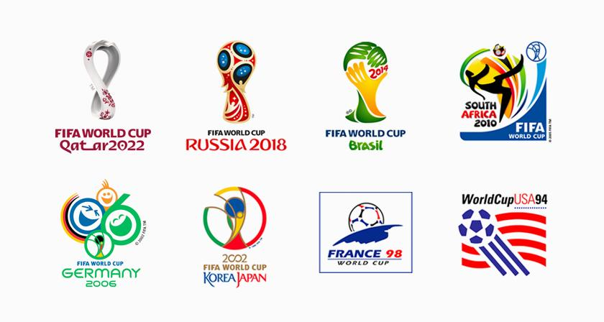
The FIFA World Cup, often simply called the World Cup, is an international association football competition contested by the senior men's national teams of the members of the Federation Internationale de Football Association (FIFA), the sport's global governing body. The championship has been awarded every four years since the inaugural tournament in 1930, except in 1942 and 1946 when it was not held because of the Second World War.

Slide 4
Year - The year in which the match was played.
Stage - The stage at which the match was played.
Stadium - Stadium name where the match was held.
Location - The city name, where the match was played.
Home team - Home team’s country name.
Home Goals - Total goals scored by the home team.
Away Goals - Total goals scored by the away team.
Away Team - Away team’s country name.
Goals Scored - Total goals scored in the world cup tournament.
HT Discipline - number of penalty cards in the match.
Champion - Team who won the FIFA world cup.
Runner up - Team who won the second place.
Third place - Team who won the third place.
Fourth place - Team who won the fourth place.
AVG goals per game - average value of total matches and total score.
Matches Played - Total matches played in the Tournament.

Slide 5
Top 10 Countries of Win Rate of World Cup
Win Rate of World Cup by Region
Participants of Semi-finals and Finals
Top 10 Countries of Average Goal
Top 10 Countries with Discipline cards
Correlation of Win Rate and others

Slide 6
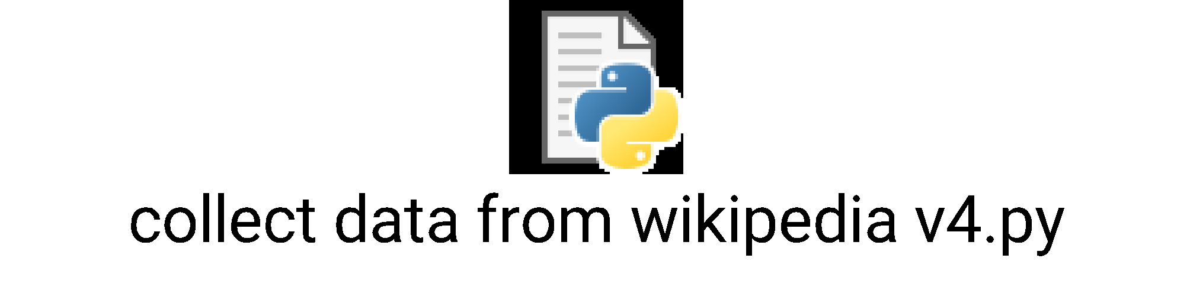
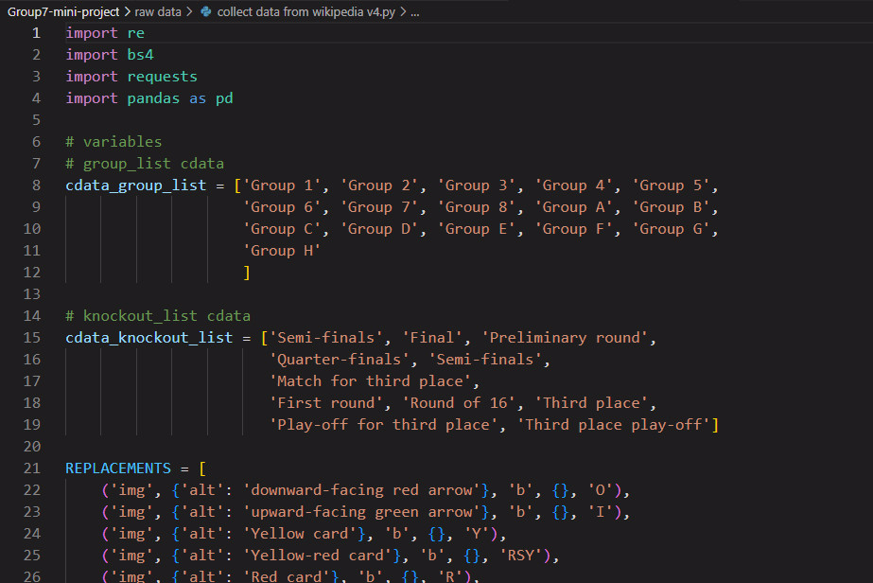
Techniques in the project
Use the library : requests, re, pandas, numpy, bs4.
Read and retrieve data by tags.
Distribute data into variables and create
data frames from those variables .
Use loops for processing.
Finally, export the excel file on the fully
collected data frame.
Crawl data

